Slide 1
Software Engineering Laboratory CS29006
Abir Das
Computer Science and Engineering Department
Indian Institute of Technology Kharagpur

Slide 2
Agenda
Getting familiar with some efficient tools in Python
Getting familiar with OOP concepts in Python
Getting familiar with numpy and matplotlib
Getting to know what is captioning images and zero-shot classification
Assumption: You are already familiar with basics of Python e.g., conditions, loops, functions, different containers.
All codes used in this slide as well as codes to get you started on the assignments are in the public github repo: https://github.com/dasabir/CS29006_SW_Lab_Spr2023

Slide 3
Getting Started
Running Python:
There are many ways to install Python on your laptop/PC/server etc.
https://www.python.org/downloads/
https://www.anaconda.com/download/
There are many editors as well
Eclipse
Jupyter notebook/lab
Spyder
PyCharm
VSCode
Text editors like Sublime Text

Slide 4
Our Choice is Popular
Anaconda:
Anaconda is a distribution of programs in Python (and R) language and includes a huge number of libraries and several tools.
These include the Spyder development environment and Jupyter notebooks.
You can create your own customized environment which is independent of what you have in your PC/Laptop/Server already.

Slide 5
Installing Anaconda
Download and install Anaconda for your OS -- https://www.anaconda.com/products/individual#Downloads -- Note that the most recent python version is 3.11 here. There are two versions of the installer – Graphical and Commandline. Graphical works on windows/mac while Commandline works on mac/Linux [In the above link the linux specific installer is called just ‘installer’ [i.e., without the word ‘commandline’ in it]]. If you have the option, use Commandline installation [that will be my choice].
Depending on your OS please follow the steps as listed in the following links.
Installing on Windows
Installing on macOS
Installing on Linux

Slide 6
Installing Anaconda
Straightaway after installing, you can use spyder and jupyter notebook ides. Get started from -- https://docs.anaconda.com/anaconda/user-guide/getting-started/
If you can run till this, you are ready for the lab! However I shall continue to use eclipse editor [Sorry – comfort zone]. In eclipse you need to add PyDev plugin -- https://docs.anaconda.com/anaconda/user-guide/tasks/integration/eclipse-pydev/

Slide 7
Sources
Materials for these slides are taken majorly from the following websites.
https://www.thedigitalcatonline.com/blog/2014/08/20/python-3-oop-part-1-objects-and-types/
https://www.pythonlikeyoumeanit.com/intro.html
https://cs231n.github.io/python-numpy-tutorial/

Slide 8
Iterables
An iterable is any Python object capable of returning its members one at a time, permitting it to be iterated over a loop.
Examples:- lists, tuples, and strings etc.
Iterables help to write efficient codes using the concept of ‘generators’ – which we will come at a later slide.
Some useful built-in functions that accept iterables as arguments:
list, tuple, sum, sorted etc.
Demo time

Slide 9
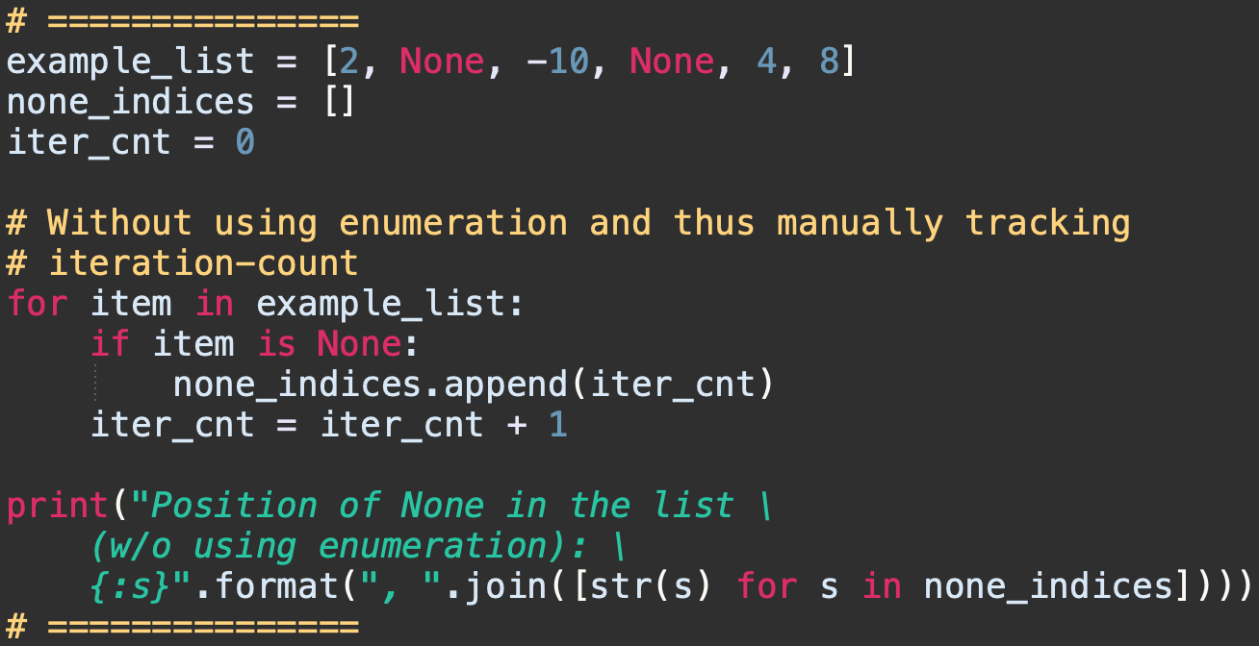
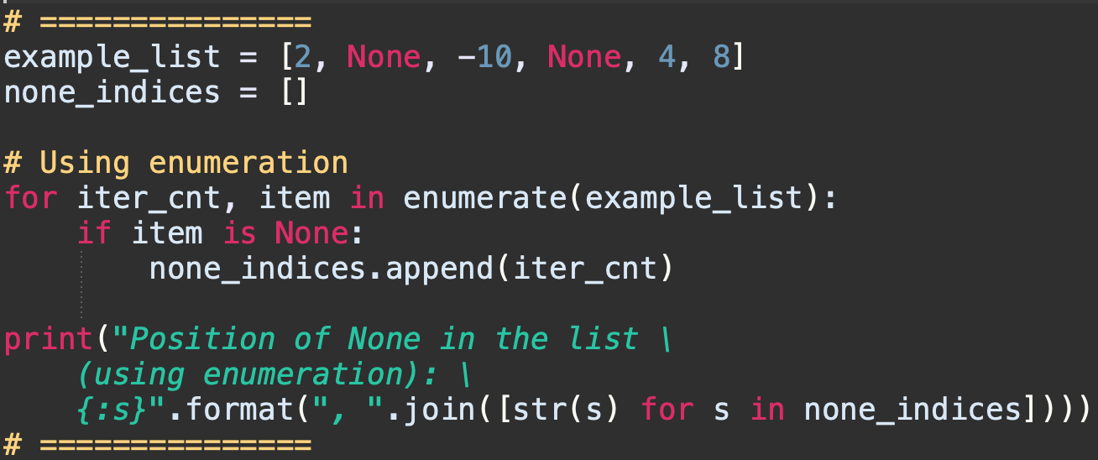
Enumerating Iterables
The built-in enumerate function allows to iterate over an iterable, while keeping track of the iteration count.
The enumerate function accepts an iterable as an input and the items in the iterable are enumerated.
Example code illustrating simplification of code. Problem statement is – to record all the positions in a list where the value None is stored.

Slide 10
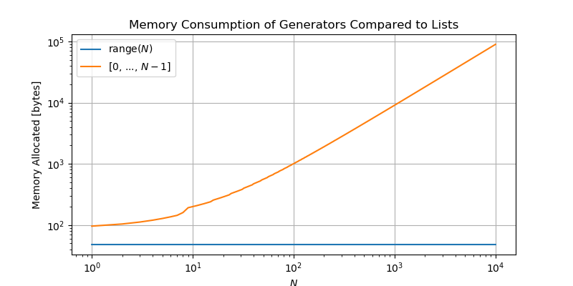
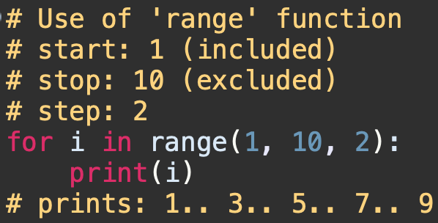
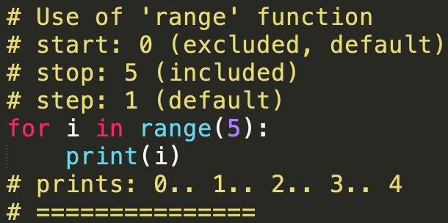
Generators
Generators allow us to generate arbitrarily-many items in a series, without having to store them all in memory at once.
Recall that a list readily stores all of its members. A generator, on the other hand, stores the instructions for generating each of its members, and stores its iteration state; this means that the generator will know if it has generated its second member, and will thus generate its third member the next time it is iterated on.

Slide 11
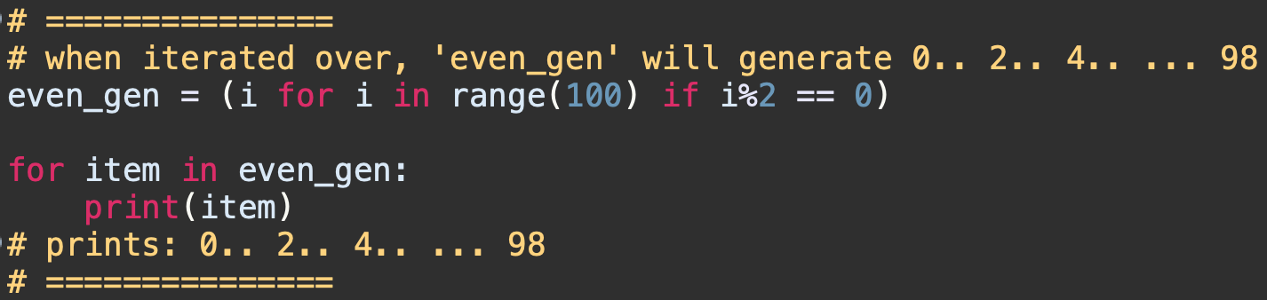
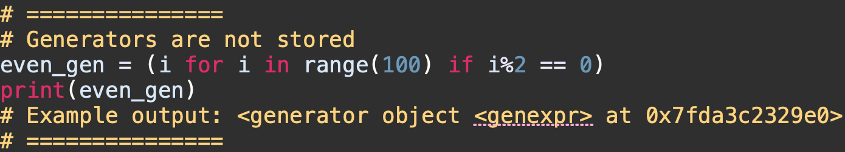
Generator Comprehensions
Python provides a sleek syntax for defining a simple generator in a single line of code – known as Generator Comprehension
The syntax is - (<expression> for <var> in <iterable> [if <condition>])
(<expression> can be any valid single-line of Python code that returns an object:
Generator comprehensions do not store values.

Slide 12
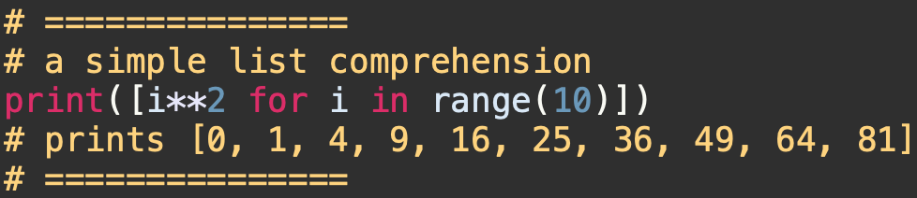
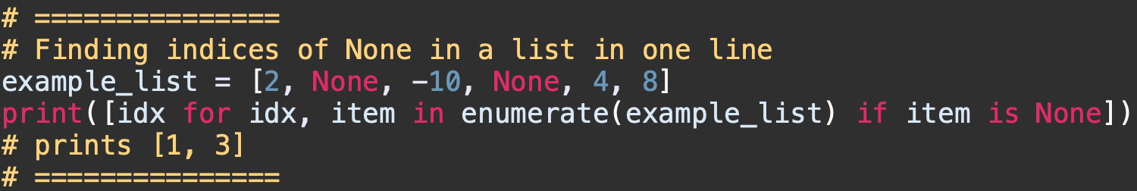
List (and Tuple) Comprehensions
Using generator comprehensions to initialize lists is so useful that Python actually reserves a specialized syntax for it, known as the list comprehension
The syntax is: [<expression> for <var> in <iterable> {if <condition}]
Revisiting the example of finding index of ‘None’ in a list

Slide 13
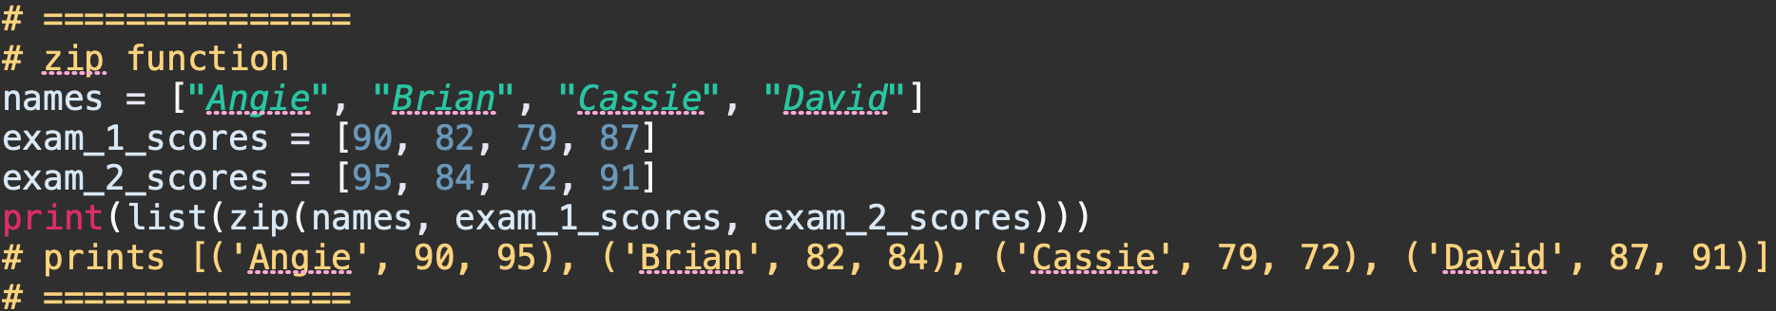
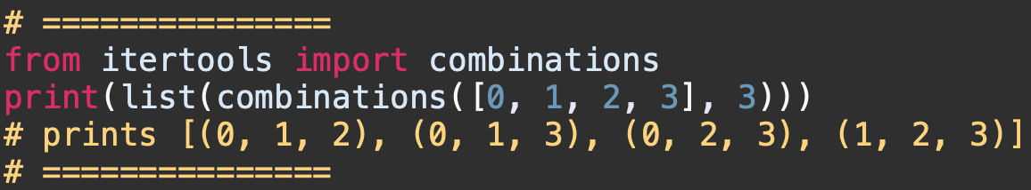
Itertools
Python has an itertools module, which provides a core set of fast, memory-efficient tools for creating iterators. The majority of these functions create generators, thus we will have to iterate over them in order to show the use of them.
zip: Zips together the corresponding elements of several iterables into tuples.
itertools.combinations: Generate all length-n tuples storing “combinations” of items from an iterable:

Slide 14
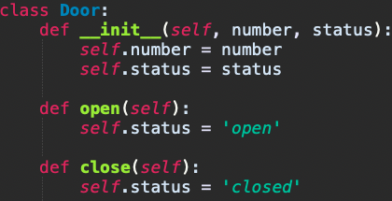
Object Oriented Programing in Python
We will discuss some key terminology for object-oriented programming in python. Most references will be made along the topics getting covered in the theory class.
The class keyword is reserved for defining a class.
The following defines a new class of object, named Door, specifying two attributes number and status, and two member functions open and close.

Slide 15
Creating Objects
Methods of a class must accept as first argument a special value called self (the name is a convention but please never break it).
The special method __init__() works as the constructor.
door1 = Door(1, 'closed’)
print(door1.number) # gives 1
print(door1.status) # gives closed
door1.open()
No arguments have been passed. But, it was declared to accept an argument (self). When you call a method of an instance, the instance is passed to the method as first argument automatically.
print(door1.status) # gives open
print(type(door1)) # gives <class '__main__.Door’>
type() returns the class as __main__.Door since the class was defined directly in the interactive shell, that is in the current main module.

Slide 16
Playing with Addresses
Create one more Door object with same attributes
door2 = Door(1, 'closed’)
print(hex(id(door1))) # gives 0x7faebb2c1310
print(hex(id(door2))) # gives 0x7faebb29e1c0
print(hex(id(door1.__class__))) # gives 0x7faeb9d1de40
print(hex(id(door2.__class__))) # gives 0x7faeb9d1de40
Any Python object is automatically given a __dict__ attribute, which contains its list of attributes. Try both – “Door.__dict__” and “door1.__dict__”
You can also get the attribute value by “door1.__dict__[‘status’]” [try it]

Slide 17
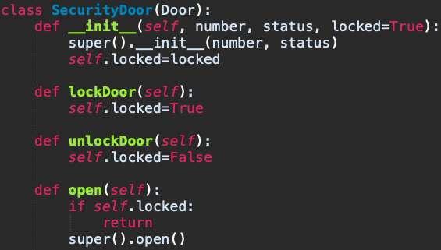
Inheritance and Overriding
Let us try to create a subclass of Door called SecurityDoor which has an additional attribute that provides the information whether the door is locked.
Instead of ‘super’ you could have used ‘Door’ [e.g., Door.__init__() or Door.open() etc]. However, using ‘super’ is encouraged as this lets python do the hierarchy resolution for multiple inheritance.
Subclass constructor
Calling superclass constructor
Override: In Python you can override a parent class member simply by redefining it in the child class.

Slide 18
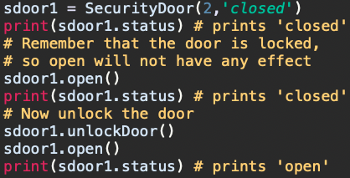
Inheritance and Overriding
Behavior of an object of type SecurityDoor.
Try the following methods.
SecurityDoor.__bases__
Print(help(SecurityDoor))

Slide 19
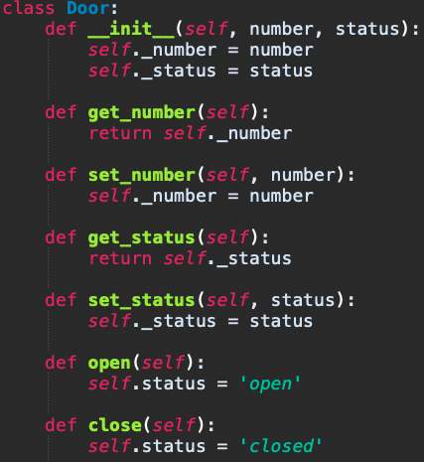
Encapsulation in Python
Python inherently does not force encapsulation. However, there are ‘pythonic’ conventions and ways to do it.
Pythonic way – Use of property decorators – getters and setters [Good resource: Link]

Slide 20
Python Magic Methods
Nothing magical about it. They are special methods with fixed names. These are a set of predefined methods you can use to enrich your classes.
They are easy to recognize because of the double underscores at the beginning and the end.
We have already encountered ‘__init__’ method.
"Underscore underscore init underscore underscore” is not easy going to pronounce. So, people say - "dunder init dunder” . ‘dunder’ is short form of ‘double underscore’
So, what's ‘magic’ about the magic or dunder methods? - The answer is, you don't have to invoke it directly. The invocation is realized behind the scenes. When you create an instance of a class, python makes the necessary call to the ‘__init__()’ method.
To get the length of a string/tuple/list etc. you can call len(). However, for an user defined class len may not work. You need to add a __len__() dunder method to fix this.

Slide 21
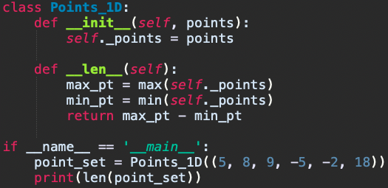
Python Magic Methods
The above prints the distance between the max and min values of the set of 1-D points.
There is a special (or a "magic") method for every operator sign. The magic method for the "+" sign is the __add__ method. For "-" it is __sub__ and so on.
List of important magic methods - Link

Slide 22
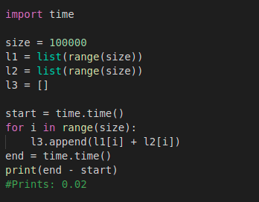
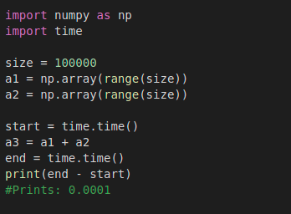
Numpy
Numpy is the core library for scientific computing in Python.
It provides a high-performance multidimensional array object, and tools for working with these arrays.
Operating on numpy arrays are way faster than looping on lists. The trick is to replace all the loops by the vectorized operations allowed on numpy arrays.
ref: https://cs231n.github.io/python-numpy-tutorial/

Slide 23
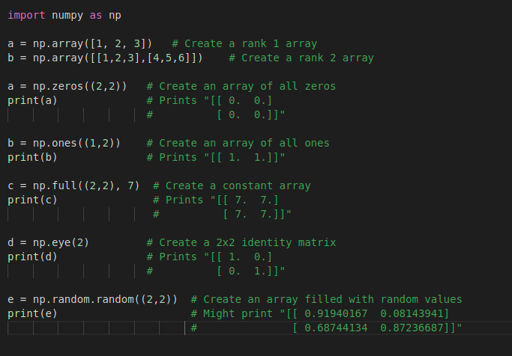
Numpy Arrays
A numpy array is a grid of values, all of the same type, and is indexed by a tuple of nonnegative integers. The number of dimensions is the rank of the array; the shape of an array is a tuple of integers giving the size of the array along each dimension.
Use np.array() to create numpy arrays from lists.
Use np.zeros(), np.ones(), np.full() etc to create numpy arrays with specific values.
Use np.random.random() to create arrays with random numbers.
ref: https://cs231n.github.io/python-numpy-tutorial/

Slide 24
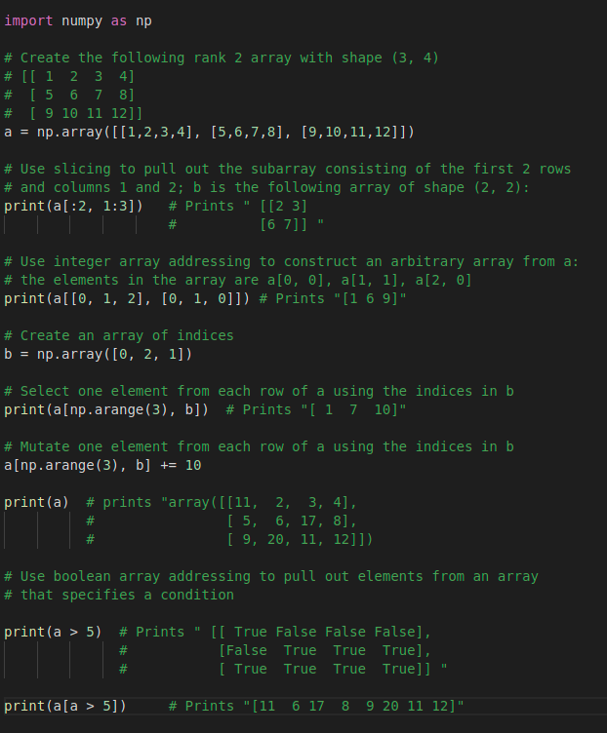
Array Indexing
Numpy offers several ways to index into arrays,
Slicing: Similar to Python lists, but you must specify a slice for each dimension of the array.
Integer Array Indexing: This allows you to construct arbitrary arrays using the data from another array.
Boolean Array Indexing: This type of indexing is used to select the elements of an array that satisfy some condition.
ref: https://cs231n.github.io/python-numpy-tutorial/

Slide 25
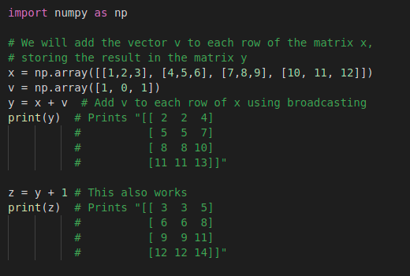
Broadcasting
Broadcasting is a powerful mechanism that allows numpy to work with arrays of different shapes when performing arithmetic operations.
The line y = x + v works even though x has shape (4, 3) and v has shape (3,) due to broadcasting; this line works as if v actually had shape (4, 3), where each row was a copy of v, and the sum was performed elementwise.
Similarly, 1 is added as it has been copied to all elements of an array of shape (4, 3).
Broadcasting does not work on any arbitrary array shapes. It follows certain rules.
A good article - Link
ref: https://cs231n.github.io/python-numpy-tutorial/

Slide 26
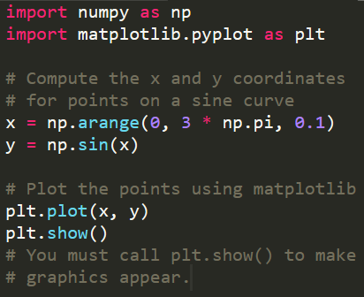
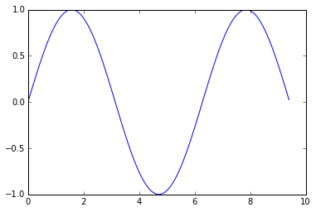
Matplotlib (Pyplot)
Matplotlib is one of the most popular Python packages used for data visualization.
The most important function is plot, which allows you to plot 2D data. Simple example:
ref: https://cs231n.github.io/python-numpy-tutorial/

Slide 27
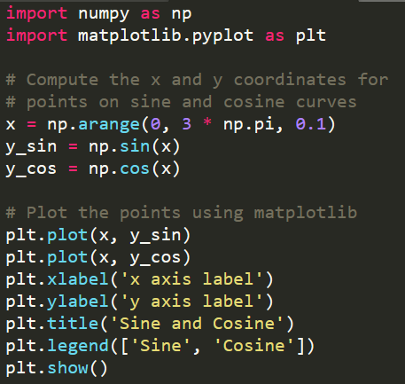
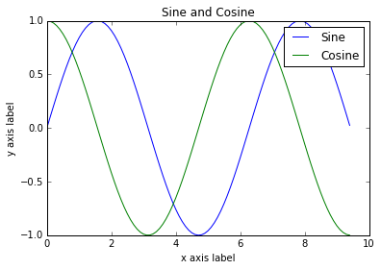
Multiple plots, legends, and axis labels
ref: https://cs231n.github.io/python-numpy-tutorial/

Slide 28
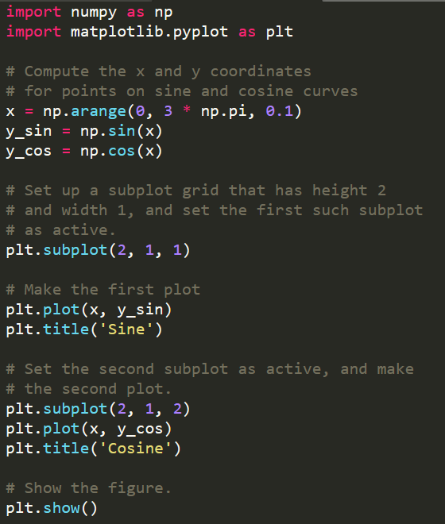
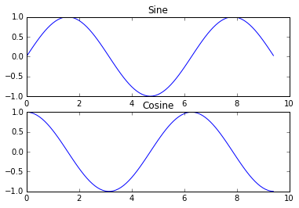
Subplots (different things in the same figure)
ref: https://cs231n.github.io/python-numpy-tutorial/

Slide 29
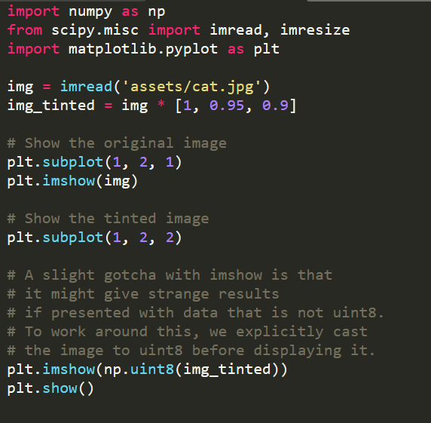
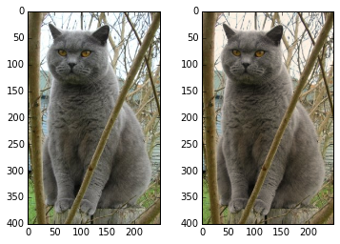
Displaying Images
You can use the imshow function to show images.
ref: https://cs231n.github.io/python-numpy-tutorial/

Slide 30
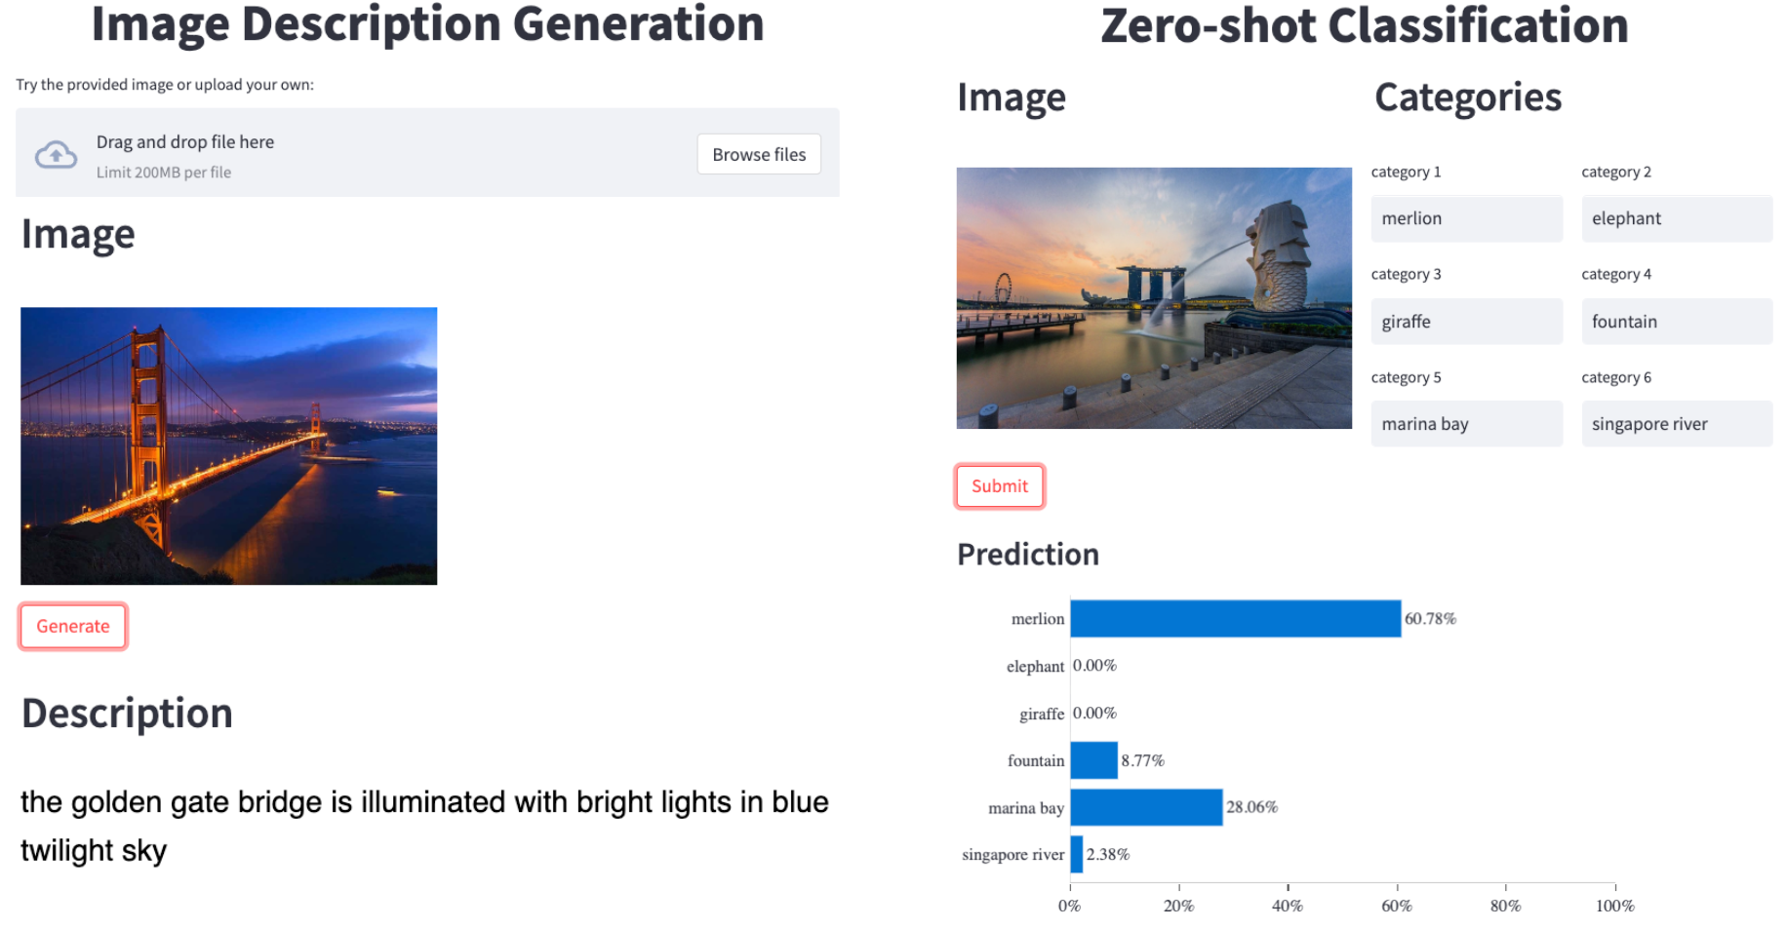
Image Caption/Description
ref: https://github.com/salesforce/LAVIS

Slide 31
Zero-shot Image Classification
ref: https://github.com/salesforce/LAVIS

Slide 32
Thank You

